Slide 1
Revision of Trade Manuals
International Workshop on the Integrated Use of
International Trade Statistics and Economic Statistics
23-25 November 2021
Markie Muryawan
United Nations Statistics Division

Slide 2
Outline
Mandate: UN Committee of Experts on Business and Trade Statistics –Task Team on International Trade Statistics
Concept & Definition/Manual vs. Compilation Guide/Compilers Manual
Topics for research broken down by vertical/horizontal integration
Drafting Strategies and Timeline

Slide 3
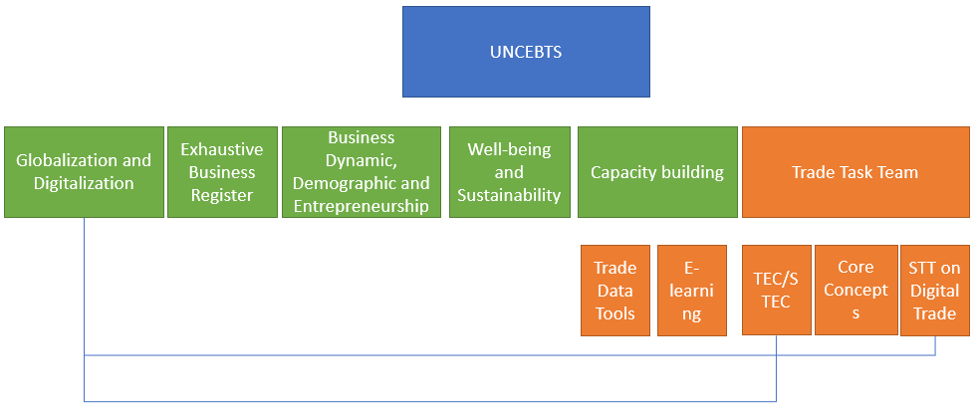
Mandates of Task Team on ITS
Lead the revision of IMTS 2010 and MSITS 2010 in collaboration with other stakeholders, notably TFITS and IMF CATT
Enhance the integration between trade and business statistics
Promote capacity building activities and collaborate on ongoing technical assistance projects
Co-leaders: Portugal and Morocco

Slide 4
What constitutes a concept & definition / manual?
Need a better separation between a Manual and a Compilation Guide
Conceptual Framework vs. Compilation Good Practice
Thin vs. Thick
Fixed vs. Living Documents
It would impact drafting strategies and timeline

Slide 5
Vertical
Horizontal
Research Topics – not exhaustive mainly due to digitalization, globalization, well-being and sustainability
Scope of IMTS and SITS – goods/services definition
Recording principle – Cross Border/Change of Ownership
Bilateral Asymmetries
Informal Cross-border Trade
Goods Valuation – Invoice, CIF, FOB
Trade System – General vs. Special
Mode of Supply
Merchanting – goods vs. services
Price/Volume measurement
Classification EBOPS
Other GNs from BPM, SNA
Emerging compilation techniques/methods
Digital trade and e-commerce
Global value chains
Linking trade and business – TEC/STEC and beyond
Well-being
Sustainability
FATS
Classification BEC Rev. 5; Business Function
Classification linked to ISIC/CPC

Slide 6
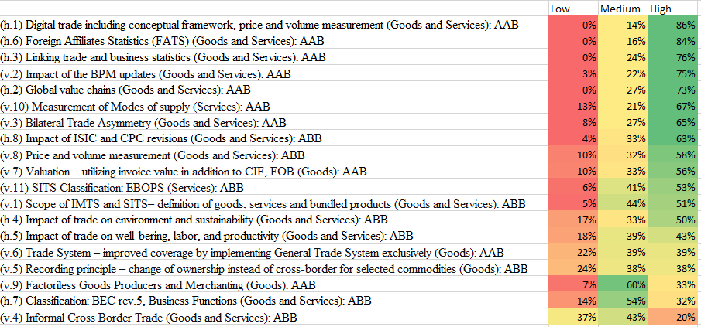
Prioritization of research topics – outcome of the 1st meeting

Slide 7
Drafting strategies and timeline
Strategies : preliminary list of guidance notes is available, it is currently under global consultation
Experts would work on specific guidance notes
For BPM/SNA GNs (vertical integration) & ISIC/CPC topics, timeline depends on their completion
For horizontal integration, timeline is more flexible but need to align to timeline of existing initiatives

Slide 8
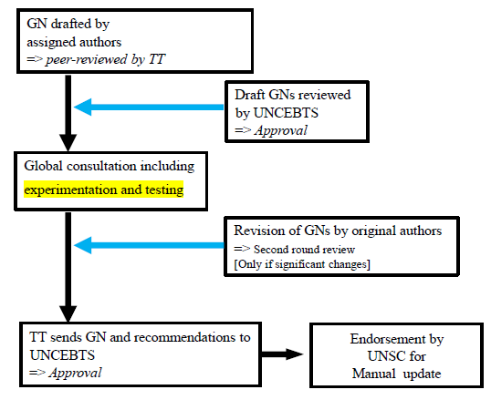
Schematic for the life cycle of Guidance Notes

Slide 9
How to get involved?
Propose a new/emerging research topic which is not yet covered
Active contribution to the drafting of Guidance Notes
Experts are welcome
Reviewing outcome of Guidance Notes in Global Consultation
Your institution becomes an official member of the Task Team
Hosting an onsite (hybrid) meeting of the Trade Task Team
Facilitating a regional consultation
Contact us:
TRADESTAT@UN.ORG

Slide 10
Thank you
muryawan@un.org

